Slide 1
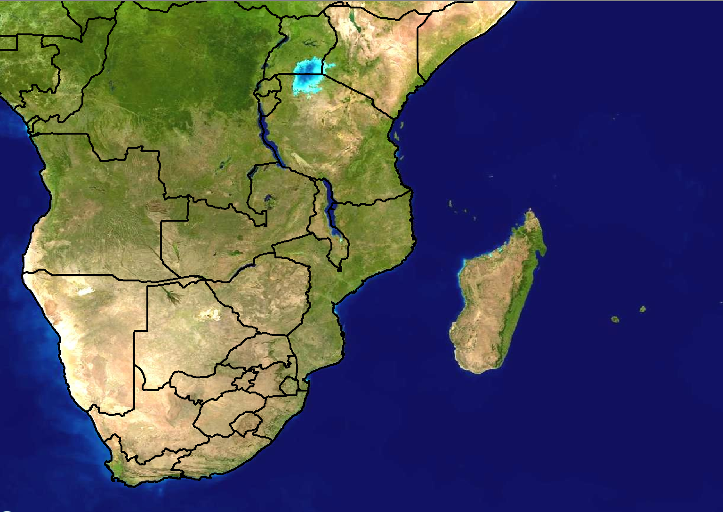
Scenario 1: Forecast for Day 3
24 hour rainfall (mm)
100
80
60
40
20
Forecast issued:
Monday 20 February
Forecast valid:
Wednesday 23 February

Slide 2
Scenario 1 - Additional information:
There is a slow moving, weak tropical low pressure that is expected to be situated north of Mauritius on Wednesday
It does not seem to be very strong at this stage, possibly only reaching tropical depression stage
No forecast has been sent by RSMC La Reunion as yet, however NWP models are showing a large area of 30-40mm north of and over Mauritius in the next 24 hours, but 80-100mm north of Mauritius.

Slide 3
Scenario 2: Forecast for Day 1 (Today)
24 hour rainfall (mm)
>100
80
60
40
20
Forecast issued:
Wednesday 23 February Forecast valid:
Wednesday 23 February

Slide 4
Scenario 2 - Additional information:
The tropical low pressure has intensified somewhat and unexpectedly moved further southeast towards Rodriguez
RSMC La Reunion sent a bulletin out yesterday and updated it today, classifying the low pressure as a tropical storm for today.
Models are in broad agreement with rainfall amounts of more than 60mm in 24 hours can affect Mauritius with higher totals in the vicinity of Rodriguez
The ECMWF model shows maximum 6 hourly rainfall amounts of >50mm between 12-18Z today while Aladin shows 30-40mm during the same period.
An isolated thunderstorm moved over Port Louis last night and there are reports of flooded roads.

